Slide 1
GREAT OUTDOORS
TEAM - A

Slide 2
TEAM A
Madhuri Vemulapaty
Ankush Agrawal
Shreyash Pandey
Sourav Maji
Sarthak Lav

Slide 3
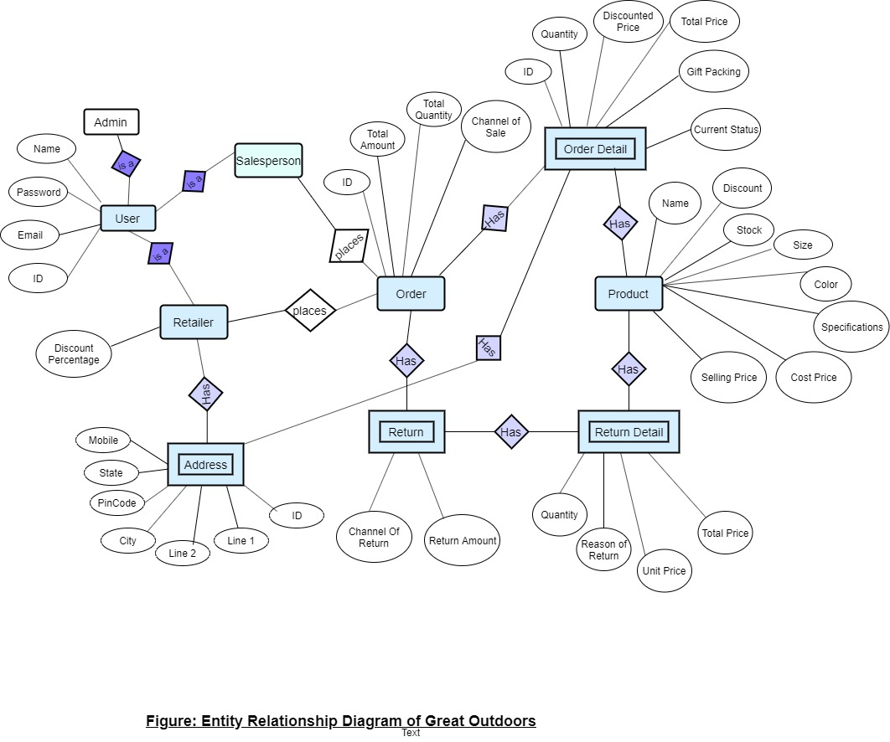

Slide 4
EPIC – Salesman should upload offline orders
User Stories:
Salesman should be able to upload order details like product ID, name and quantity along with discount and total price.
Salesman should be able to view uploaded sales.

Slide 5
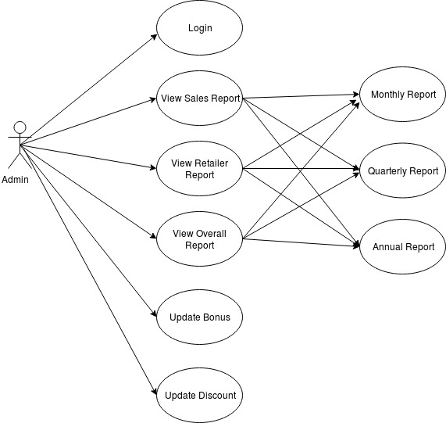
Use Case Diagram - Admin

Slide 6
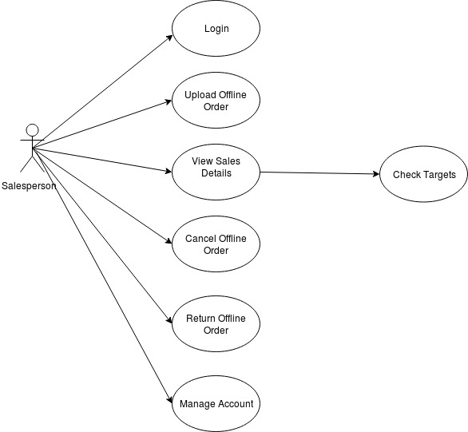
Use Case Diagram – Salesperson

Slide 7
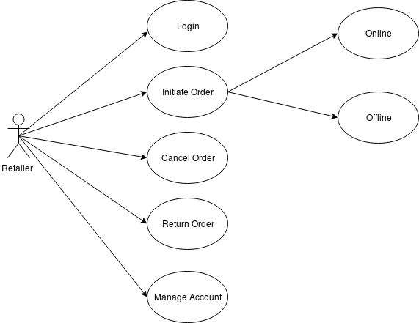
Use Case Diagram - Retailer

Slide 8
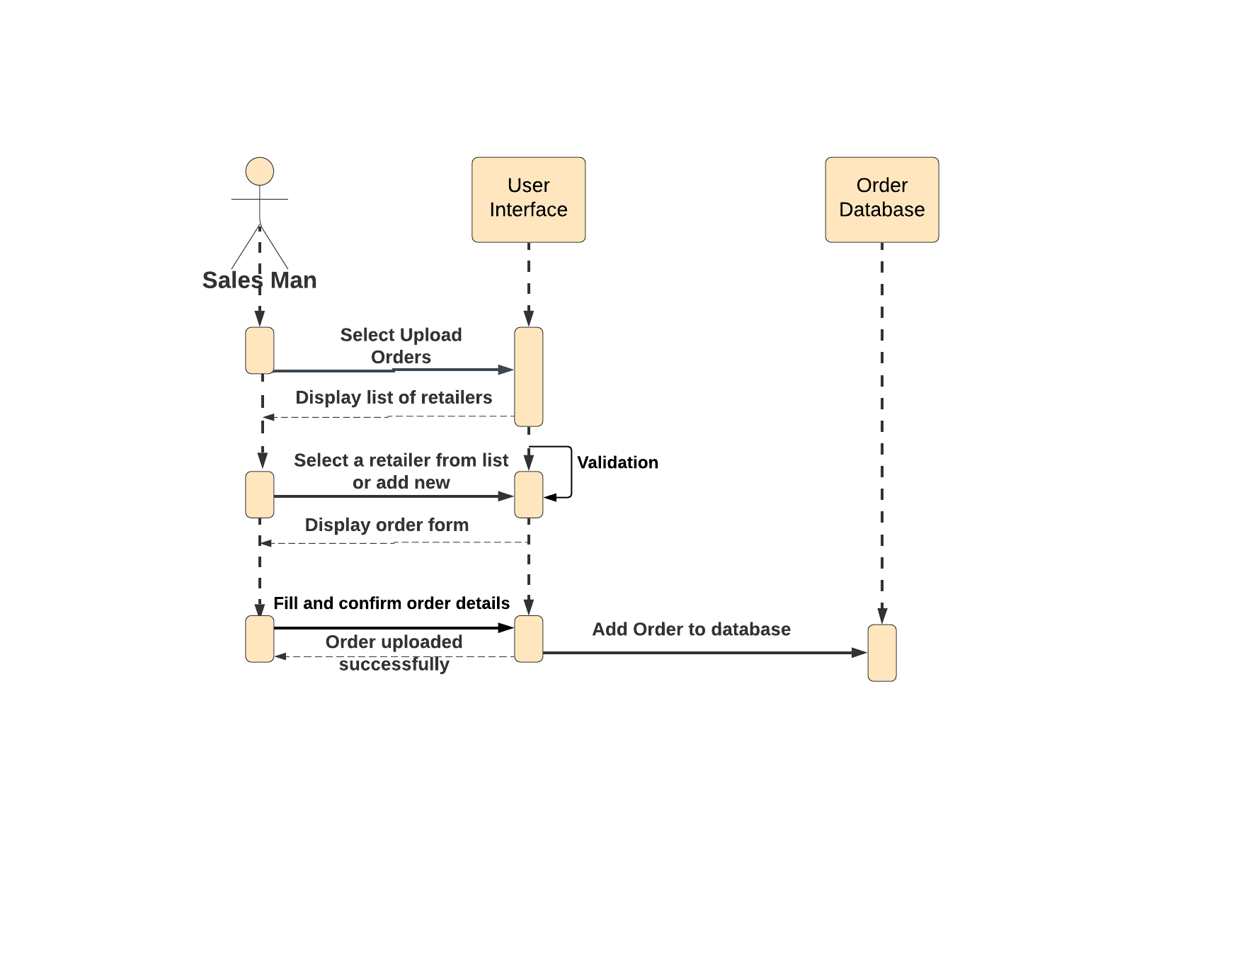
Sequence diagram to upload offline order

Slide 9
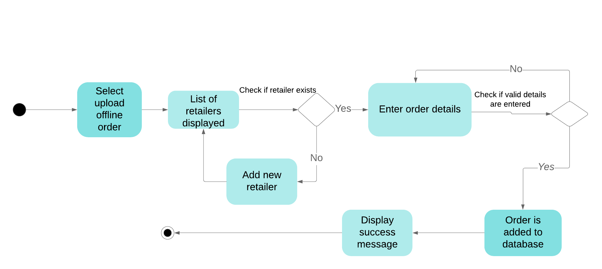
Activity diagram to upload offline order

Slide 10
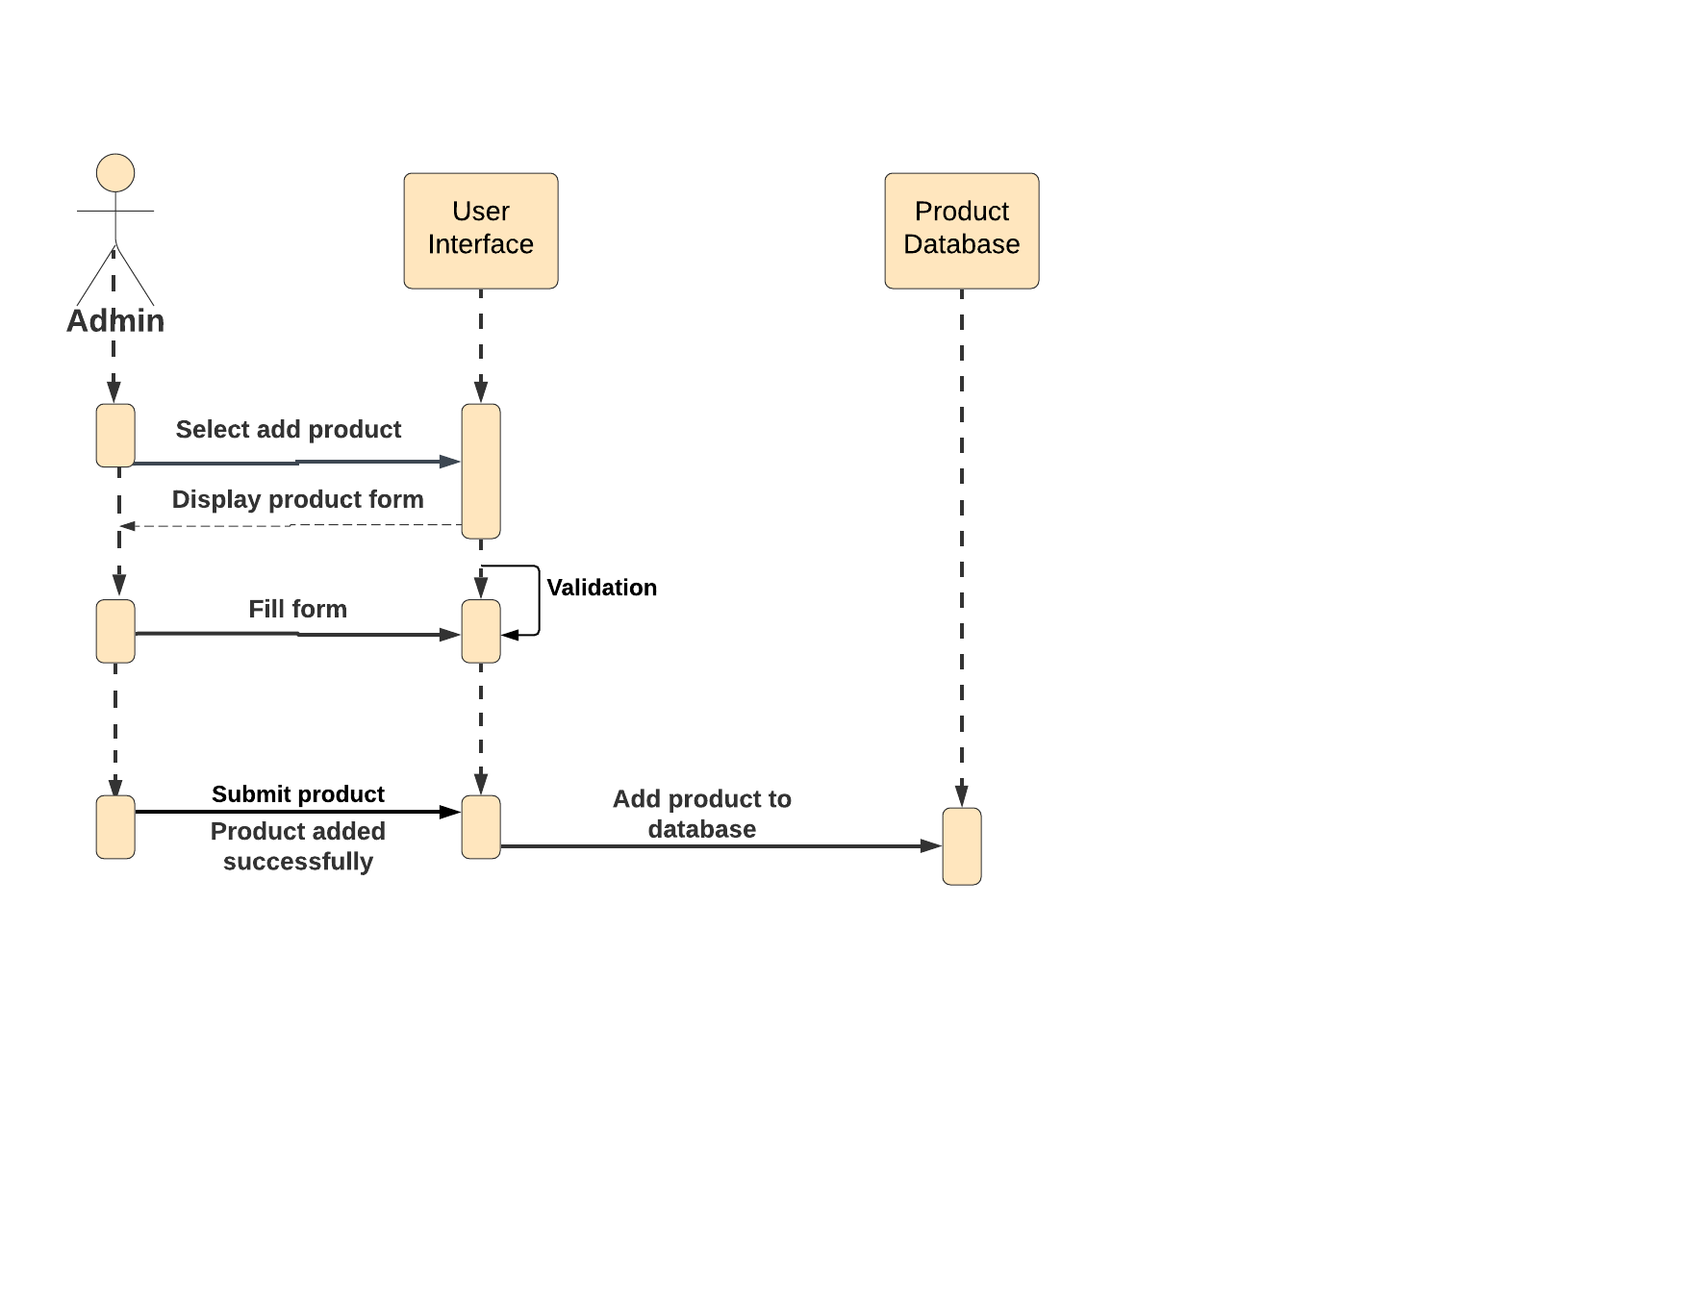
Sequence diagram to add product

Slide 11
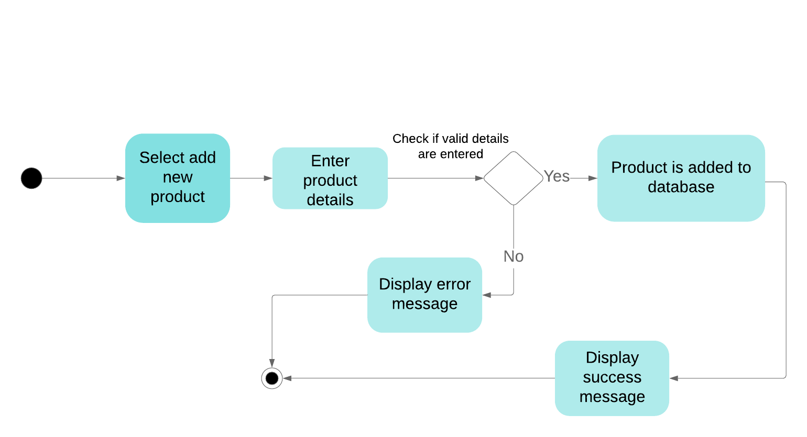
Activity diagram to add product

Slide 12
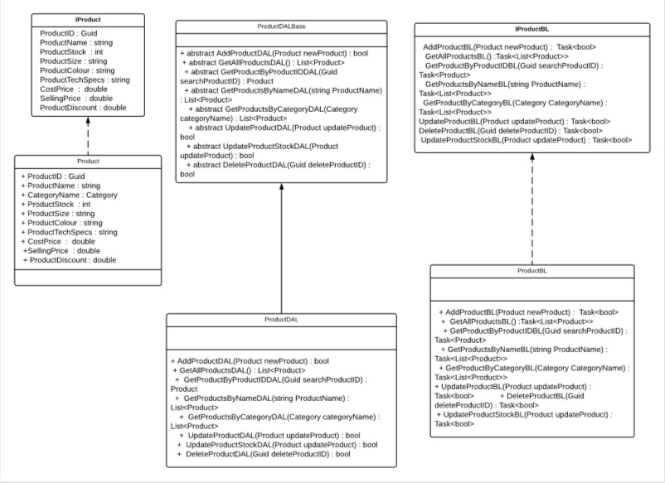

Slide 13
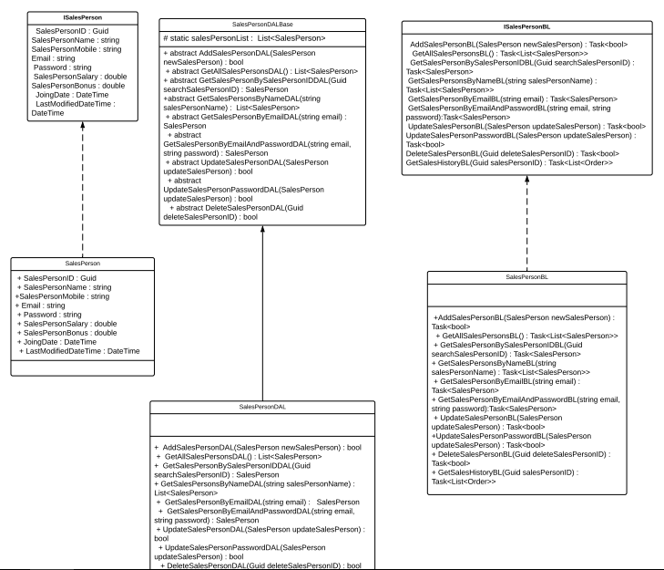

Slide 14
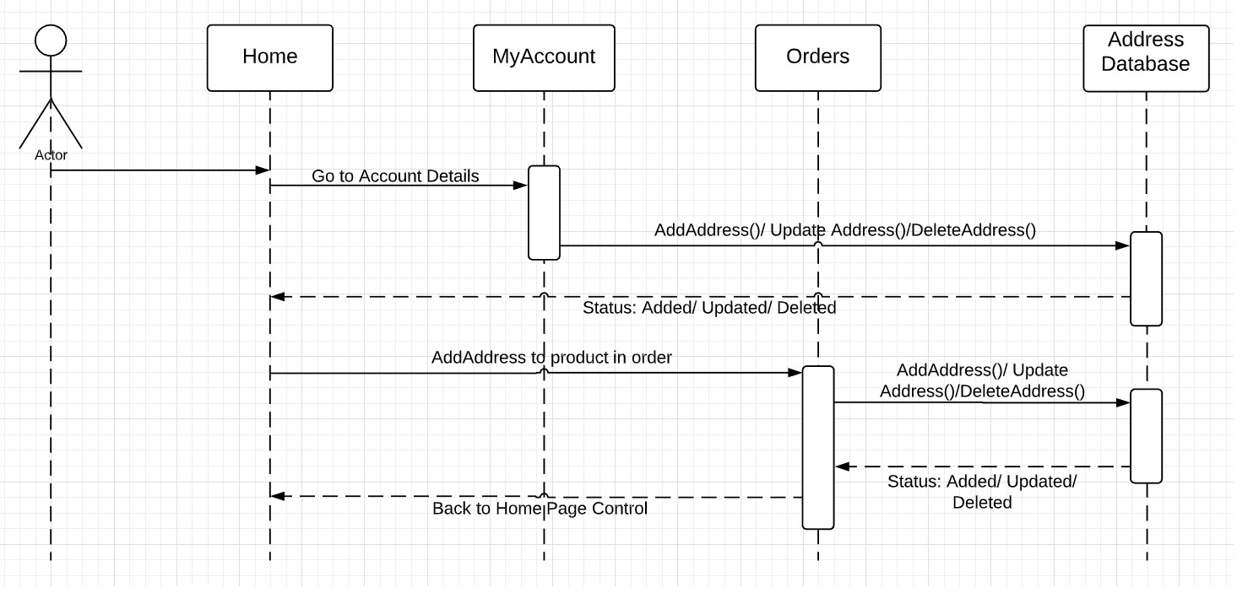
Sequence Diagram to add new address

Slide 15
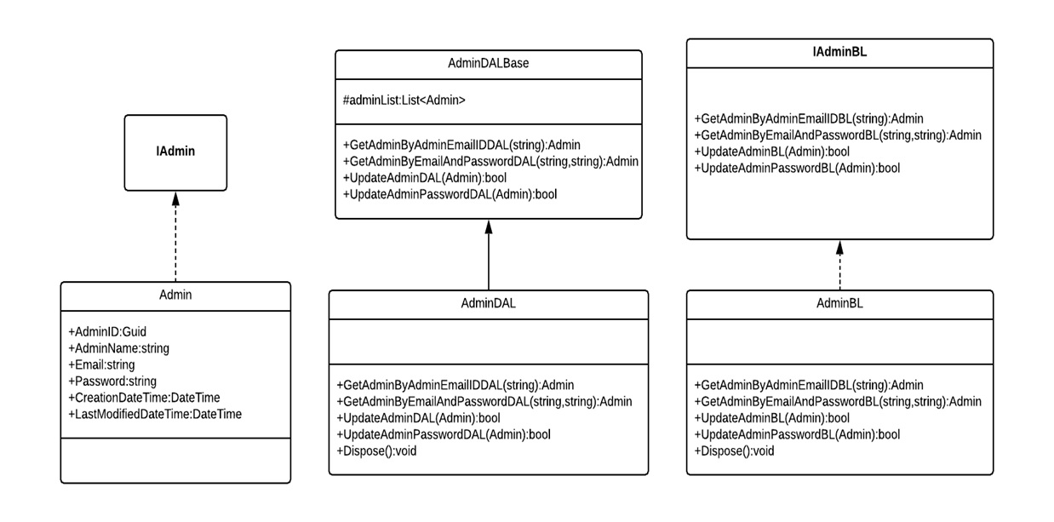

Slide 16
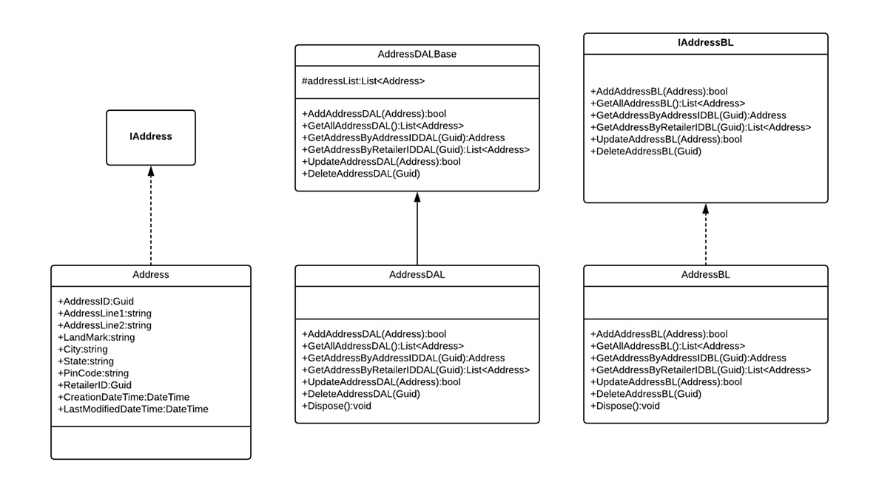

Slide 17
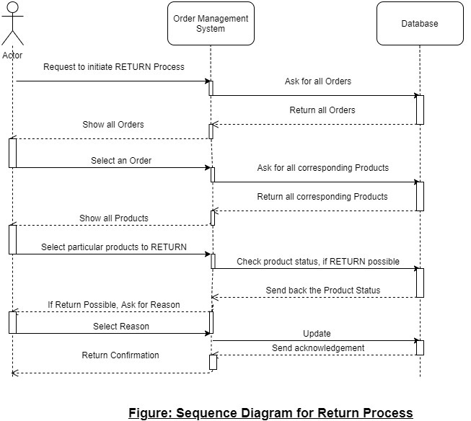
Sequence diagram for return order

Slide 18
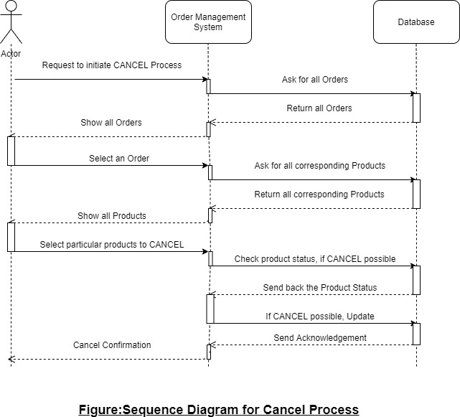
Sequence diagram to cancel order

Slide 19
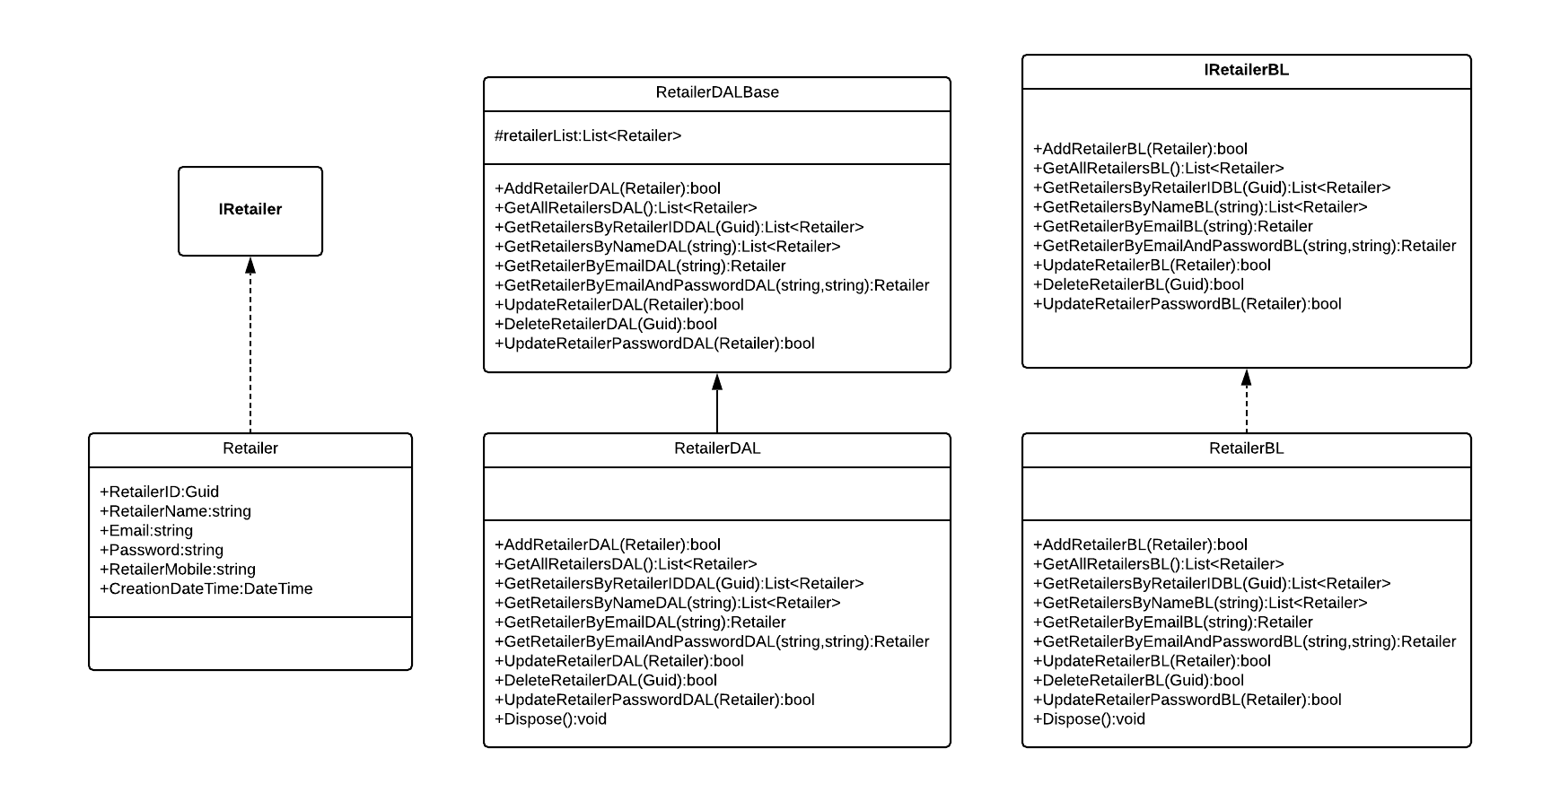

Slide 20
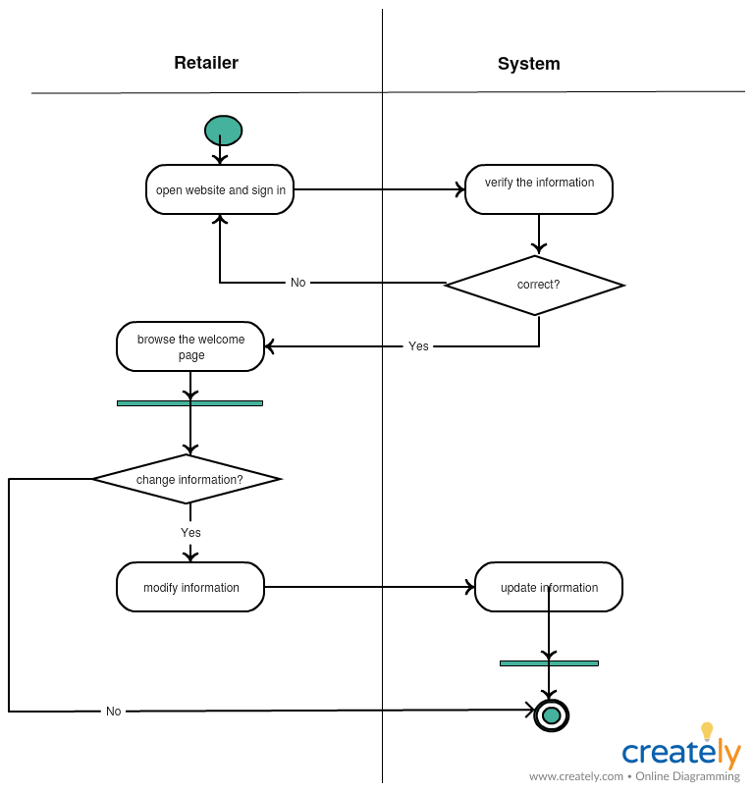
Activity diagram to update retailer

Slide 21
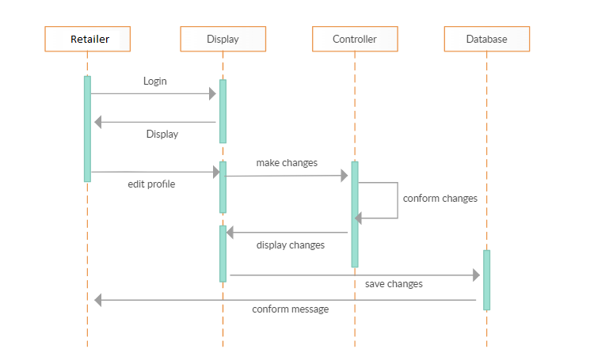
Sequence diagram to update retailer

